Slide 1
UNIT - V Analytical Learning-1- Introduction, learning with perfect domain theories: PROLOG-EBG, remarks on explanation-based learning, explanation-based learning of search control knowledge. Analytical Learning-2-Using prior knowledge to alter the search objective, using prior knowledge to augment search operators. Combining Inductive and Analytical Learning – Motivation, inductive-analytical approaches to learning, using prior knowledge to initialize the hypothesis

Slide 2
Machine Learning
Chapter 11. Analytical Learning
Tom M. Mitchell

Slide 3
Outline
Two formulations for learning: Inductive and Analytical
Perfect domain theories and Prolog-EBG

Slide 4
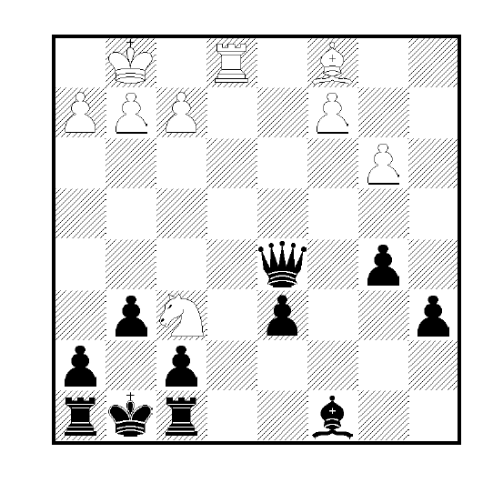
A Positive Example

Slide 5
The Inductive Generalization Problem
Given:
Instances
Hypotheses
Target Concept
Training examples of target concept
Determine:
Hypotheses consistent with the training examples

Slide 6
The Analytical Generalization Problem(Cont’)
Given:
Instances
Hypotheses
Target Concept
Training examples of target concept
Domain theory for explaining examples
Determine:
Hypotheses consistent with the training examples

Slide 7
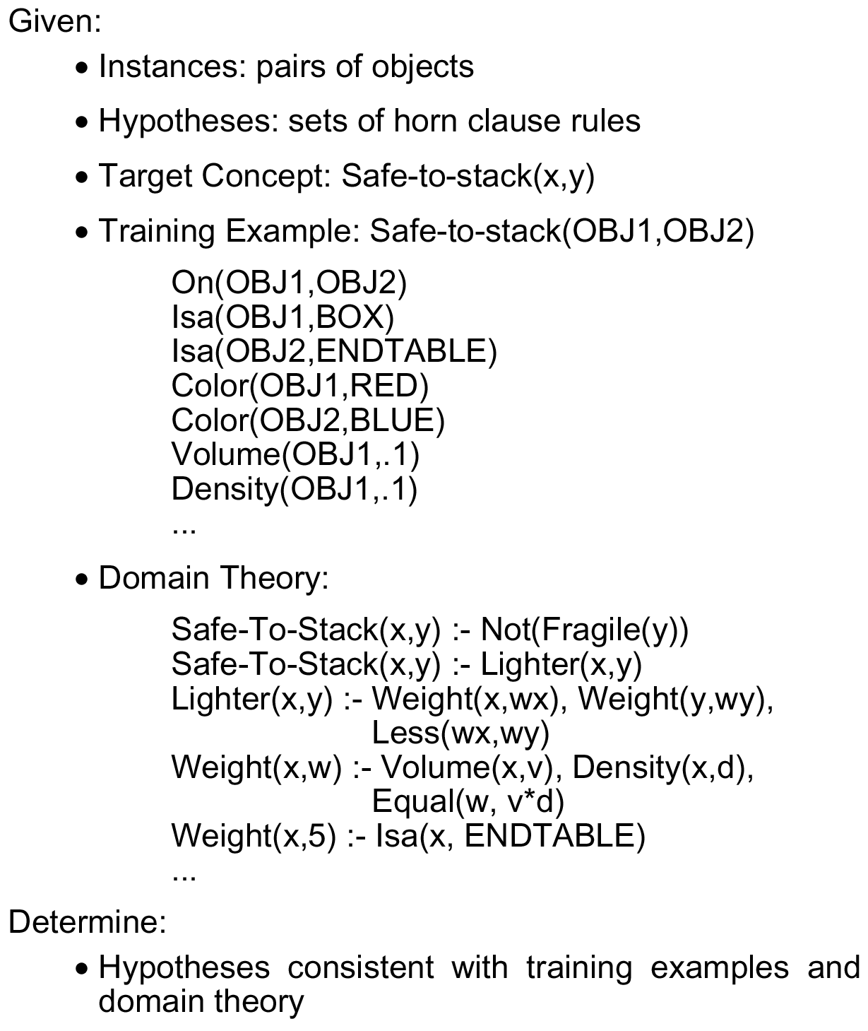
An Analytical Generalization Problem

Slide 8
Learning from Perfect Domain Theories
Assumes domain theory is correct (error-free)
Prolog-EBG is algorithm that works under this assumption
This assumption holds in chess and other search problems
Allows us to assume explanation = proof
Later we’ll discuss methods that assume approximate domain theories

Slide 9
Prolog EBG
Initialize hypothesis = {}
For each positive training example not covered by hypothesis:
1. Explain how training example satisfies target concept, in terms of domain theory
2. Analyze the explanation to determine the most general conditions under which this explanation (proof) holds
3. Refine the hypothesis by adding a new rule, whose preconditions are the above conditions, and whose consequent asserts the target concept

Slide 10
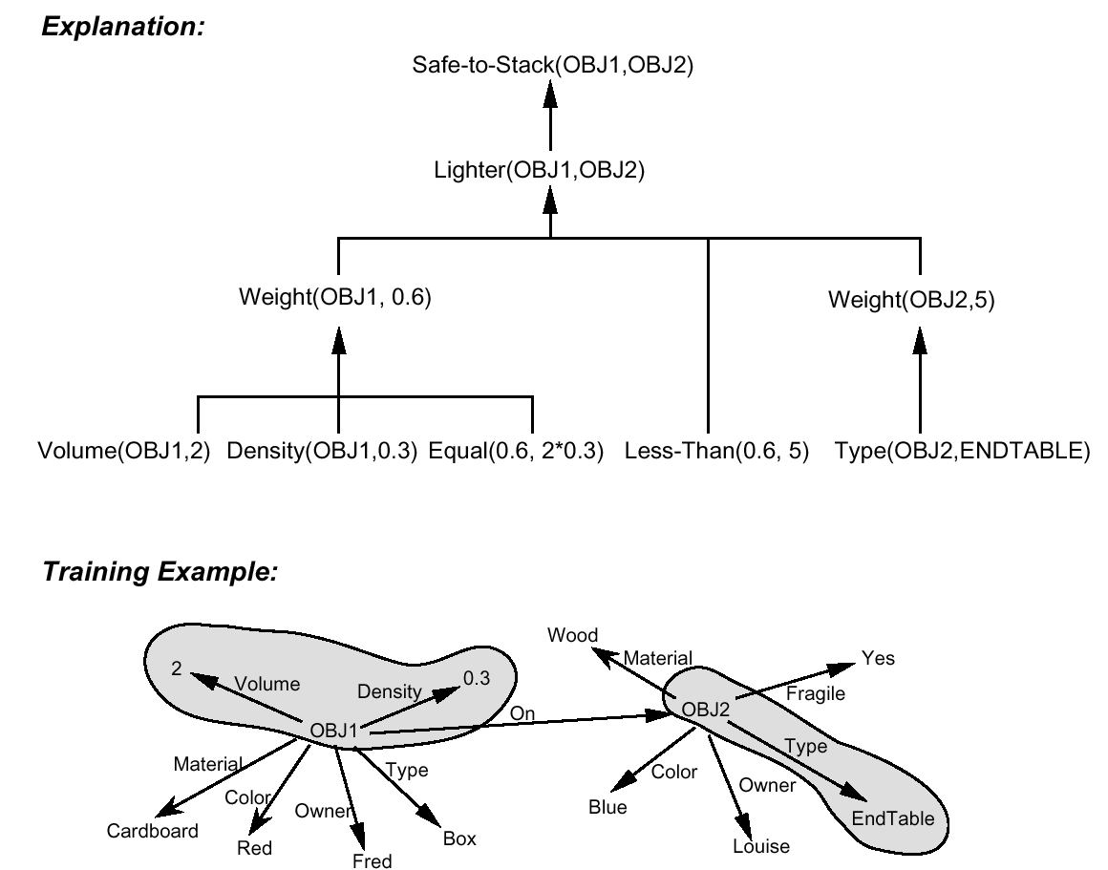
Explanation of a Training Example

Slide 11
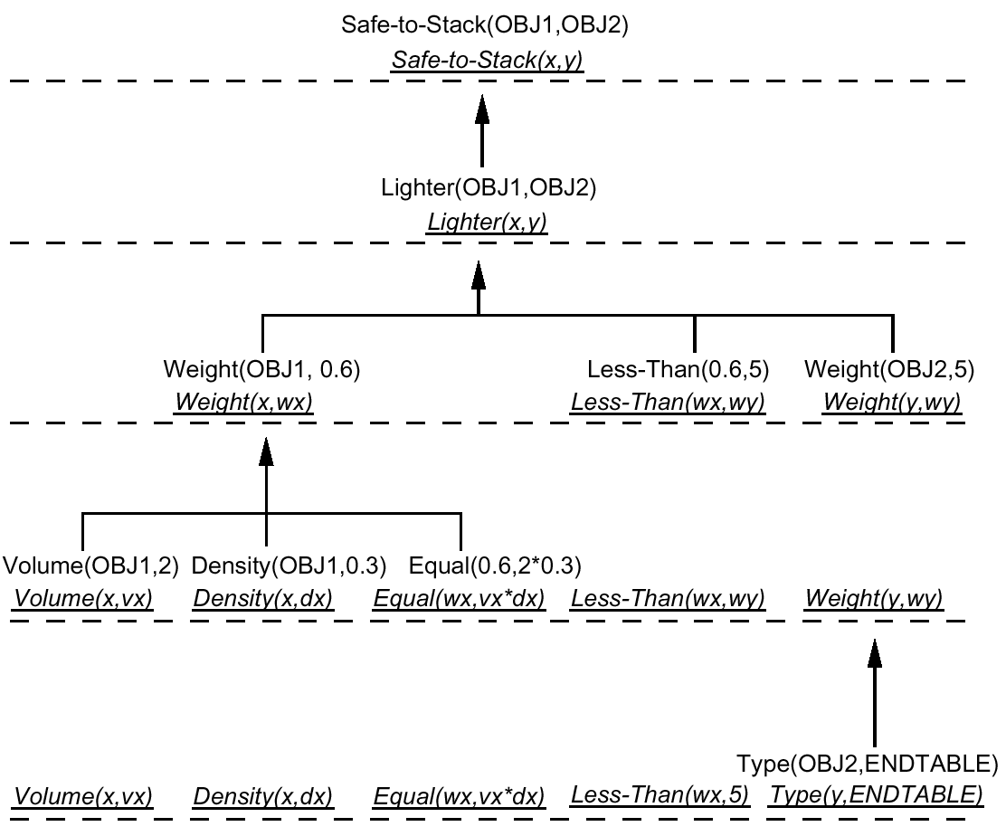
Computing the Weakest Preimage of Explanation

Slide 12
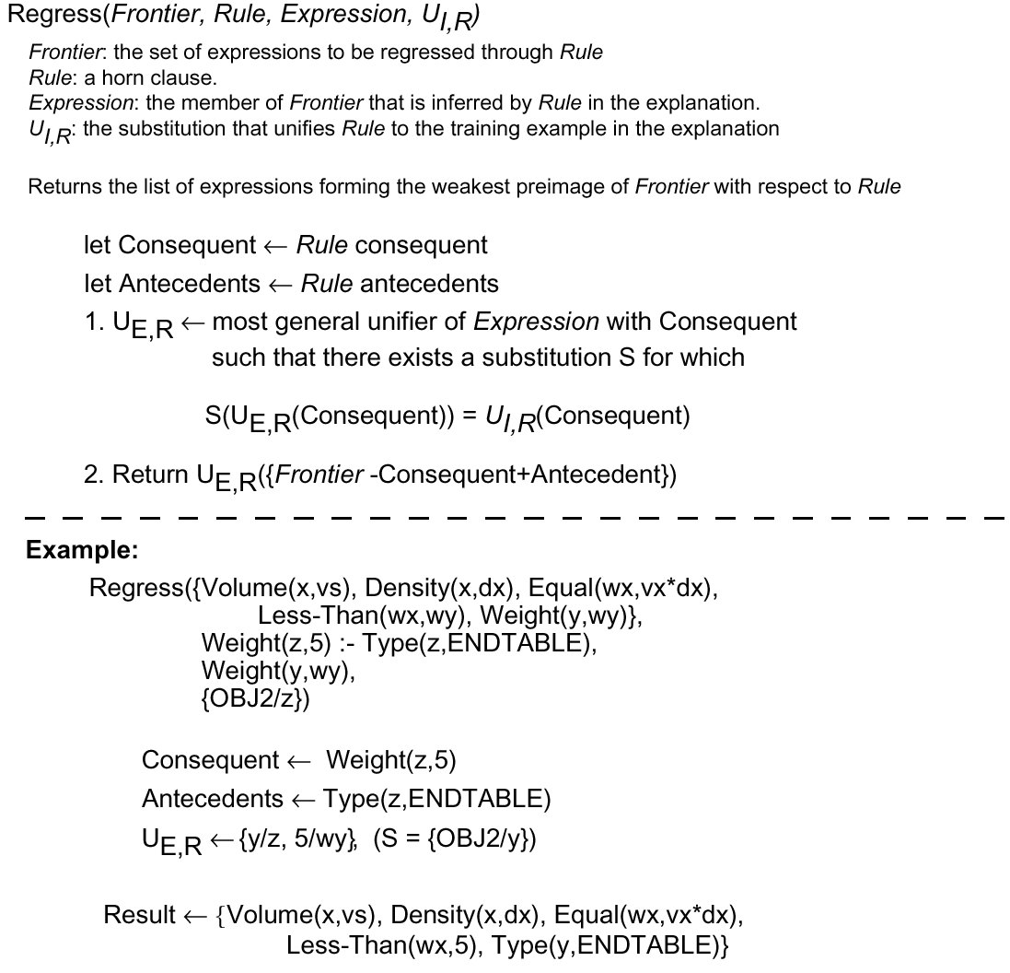
Regression Algorithm

Slide 13
Lessons from Safe-to-Stack Example
Justified generalization from single example
Explanation determines feature relevance
Regression determines needed feature constraints
Generality of result depends on domain theory
Still require multiple examples

Slide 14
Perspectives on Prolog-EBG
?
Are you learning when you get better over time at chess?
Even though you already know everything in principle, once you know rules of the game...
Are you learning when you sit in a mathematics class?
Even though those theorems follow deductively from the axioms you’ve already learned... Theory-guided generalization from examples
Example-guided operationalization of theories
"Just" restating what learner already "knows“
Is it learning

